Slide 1


Software Engineering and
Project Management
Customer Credit Transfer
CSE 312
BackBenchers
IIITK
Zishan Ahamad
Vatsal Sinha
Sagar Raj
Yogesh Raj

Slide 2
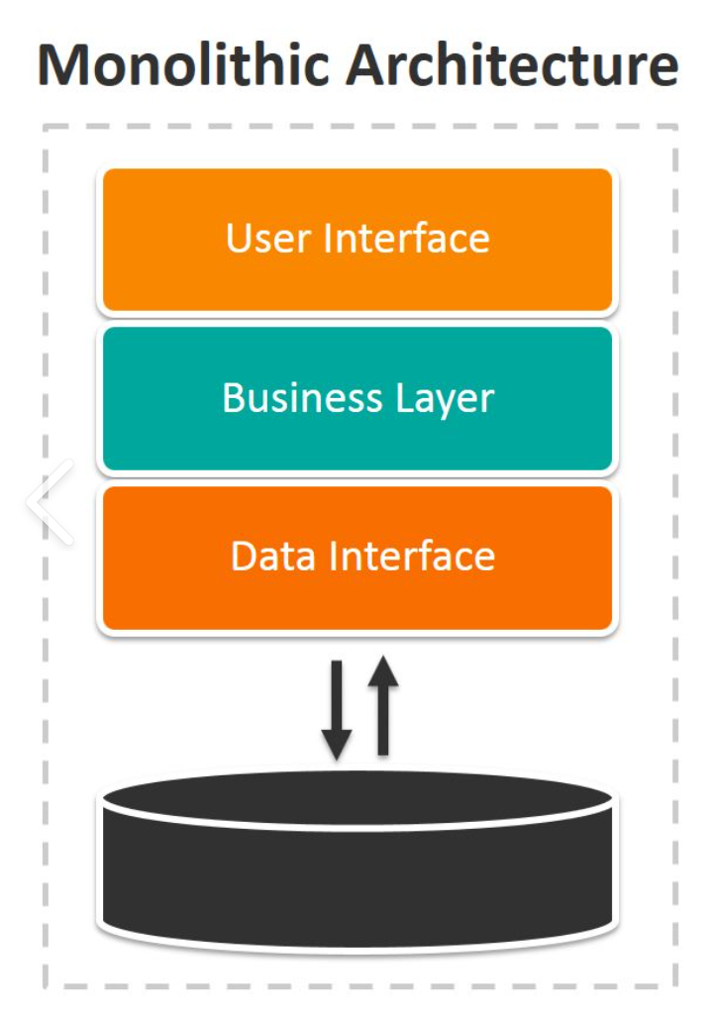
MONOLITHIC SYSTEM ARCHITECTURE
Monolithic is an all-in-one architecture.
All aspects of the software operate as a single unit.
It is tightly coupled and entangled as the application evolves, making it difficult to isolate services for purposes such as independent scaling or code maintainability.
Each component fully depends on each other.

Slide 3
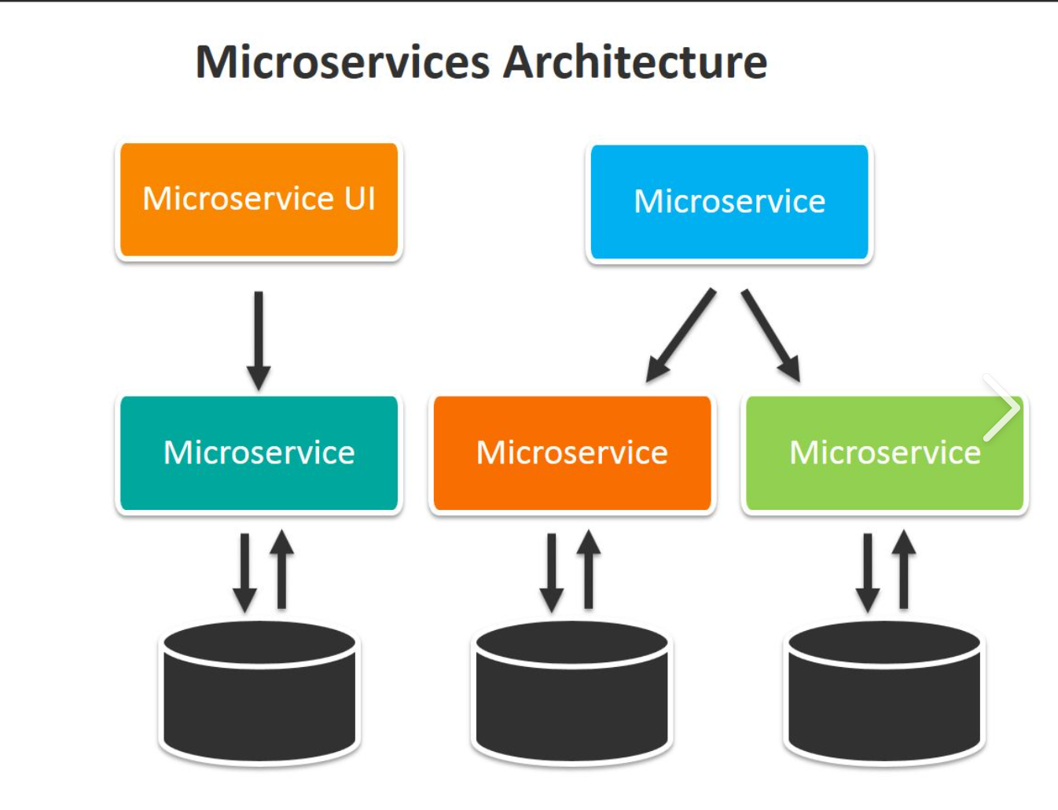
MICRO-SERVICE SYSTEM ARCHITECTURE
Microservice is the process of implementing Service-oriented Architecture (SOA) by dividing the entire application as a collection of interconnected services.
It is highly maintainable and testable.
Each component can work independently and is not affected by the performance of other components.

Slide 4
MT 103 Format File
{1:F01SOGEFRPPAXXX0070970817}
{2:O1031734150713DEUTDEFFBXXX00739698421607131634N}
{3:{103:TGT}{108:OPTUSERREF16CHAR}}
{4:
:20:UNIQUEREFOFTRX16
:23B:CRED
:32A:180724EUR735927,75
:33B:EUR735927,75
:50A:/DE37500700100950596700
DEUTDEFF
TYUTYG,BEG
PORTO
:59:/FR7630003034950005005419318
CHARLES DUPONT COMPANY
RUE GENERAL DE GAULLE, 21
75013 PARIS
:71A:SHA
-}
{5:{CHK:D628FE0165A7}}
An MT103 is an international standard legacy message format that banks and financial institutions use in the SWIFT network in order to instruct a transfer of funds from one customer to another bank customer.
MT103s are globally accepted as proofs of payment.
Includes all payment details such as date, amount, currency, sender and recipient.
Let’s Understand this Example

Slide 5
1.BASIC HEADER: The only mandatory block is the basic header. The basic header contains the general information that identifies the message, and some additional control information about the transaction process. The FIN interface automatically builds the basic header.
{1:F01SOGEFRPPAXXX0070970817}
{2:O1031734150713DEUTDEFFBXXX00739698421607131634N}
{3:{103:TGT}{108:OPTUSERREF16CHAR}}
{4:
:20:UNIQUEREFOFTRX16
:23B:CRED
:32A:180724EUR735927,75
:33B:EUR735927,75
:50A:/DE37500700100950596700
DEUTDEFF
TYUTYG,BEG
PORTO
:59:/FR7630003034950005005419318
CHARLES DUPONT COMPANY
RUE GENERAL DE GAULLE, 21
75013 PARIS
:71A:SHA
-}
{5:{CHK:D628FE0165A7}}
2.APPLICATION HEADER: The application header contains information that is specific to the application in use. The application header is required for messages that the users or the system and users, exchange. Exceptions are session establishment and session closure.
3.USER HEADER: The user header is an optional header. It consists of small details like the time and date of the generation of the transaction request and the Message Input Reference address (of the device), Banking Priority flags and check flags. NOTE: The User Header is not a mandatory field which means it is not always available until and unless the transaction method requests for it in specific transactional requests.
4.TEXT: The text is the actual data related to the transfer. It contains the transaction id and the account connection addresses along with the amount to be transferred and the valid format file of the transaction.
5.TRAILERS: The trailer either indicates special circumstances like return message and resending details and code which is relate to message handling. It also contains security information like the checksum of the message for error detection at the receivers end and the message authentication code (MAC value).

Slide 6
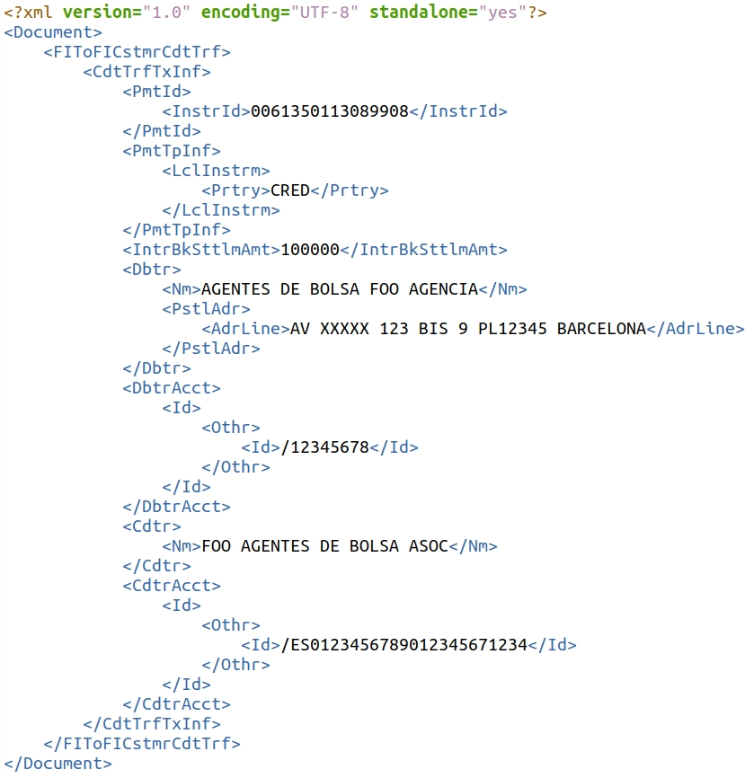
MX - PACS.008 Format File
MX messages are structured according to the ISO 20022 standard
MX messages use the XML format
MX messages are more structured, robust and comprehensive and composed of 940 separate fields

Slide 7
Benefits of MX over MT
(Simple Words)
MX format allows faster transfers with more detailed data and larger bulks of data as well (system can send and processes multiple transfer requests from one file).
The banking systems make mistakes in comprehending the complex and heavy files of MT format, rolling back and re-transfers cost time and money which will be avoided by using the MX format because of its simple format type.
Saves transaction time and load on servers thus utilizing lesser expensive resources.
XML format is easy to read and produce, thus the conversion process does not demand heavy capital to set up the new code.
As per original plan of SWIFT- MT category 1, 2 and 9 messages used in cross-border and cash reporting payments will be decommissioned in November 2025.

Slide 8
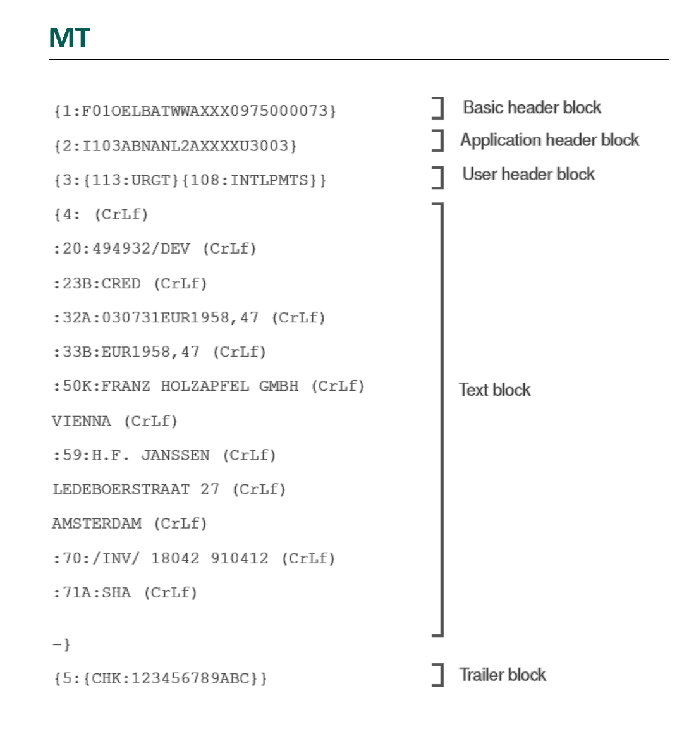
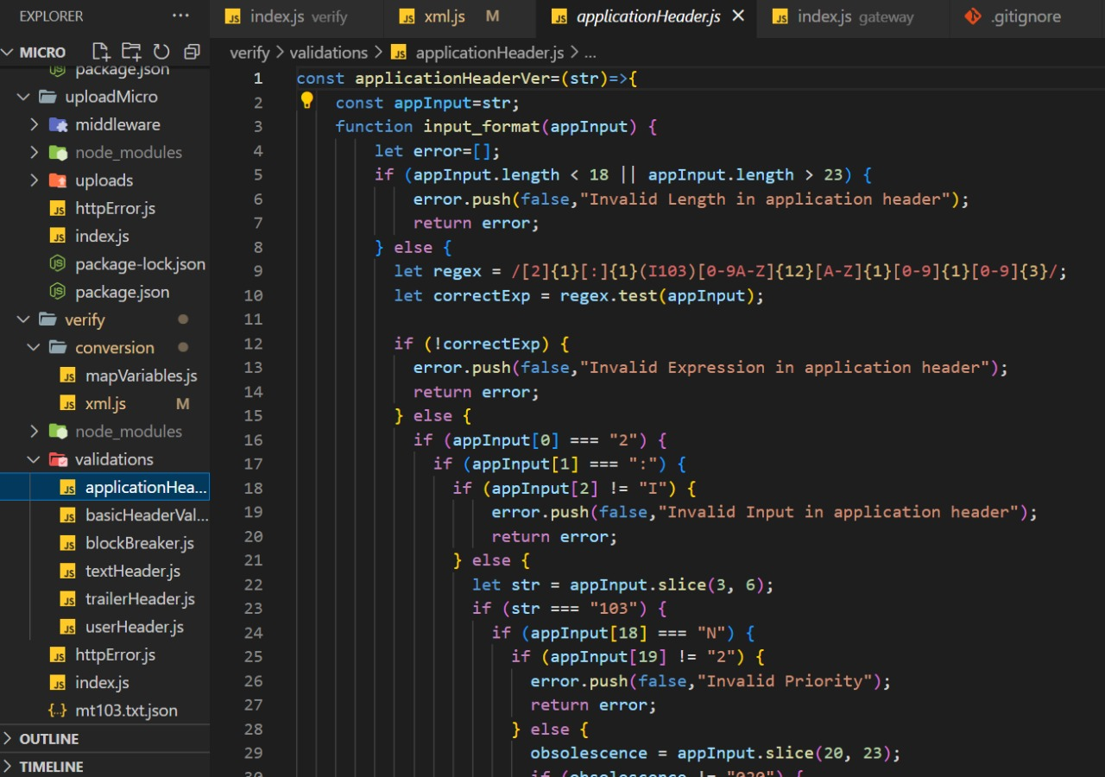
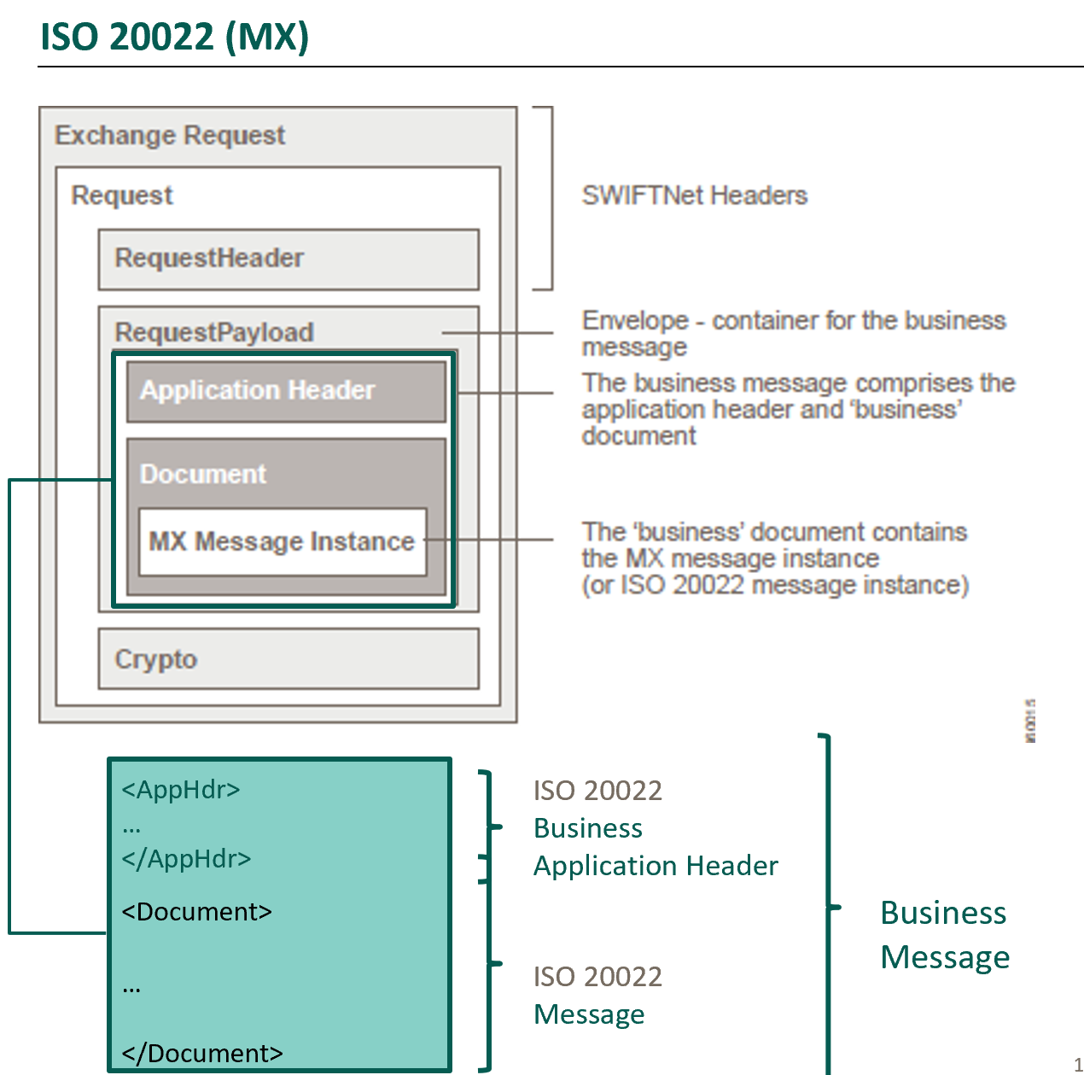
Abstract of Problem Statement
Verification Of MT 103 Format
This specification is a Payment Method specification for use with the Payment Request API. With it, merchants and payers can exchange information required for Cross Border credit transaction across payment system, by converting MT103 message (sample input file) to pacs008 MX message sample (XML file).
Once the input MT file is Uploaded we verify the format.
The verification is done based on length, tags and sectional blocks, etc..
Each field of the MT format is verified separately.
If the format is invalid, an appropriate message is returned to the client.
If verification is successful then the user can request for the MX conversion

Slide 9
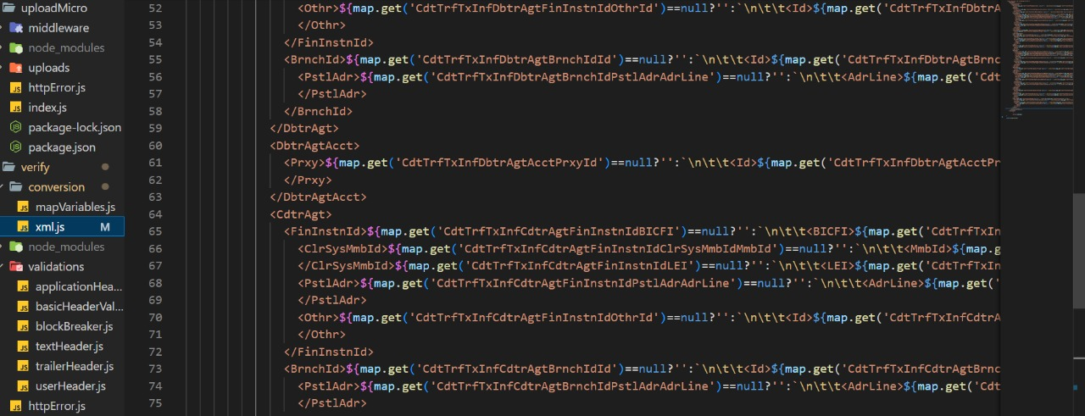
MT 103 Format to MX PACS.008 Format Conversion
When the MT to MX conversion request is sent, we are redirected to the getMX where using the predefined rules of conversion the MT file gets converted into the XML file and this new file is returned to the requester.

Slide 10
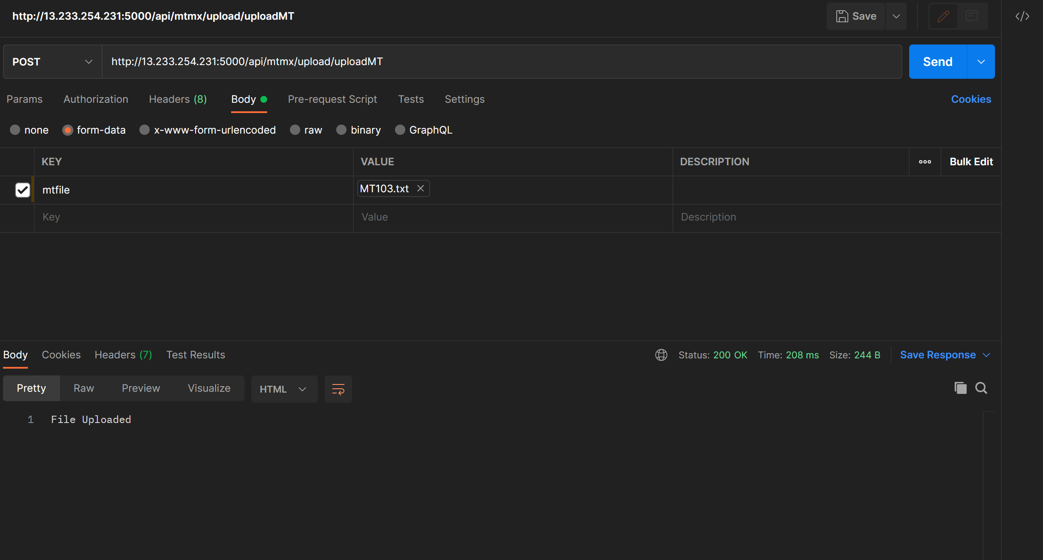
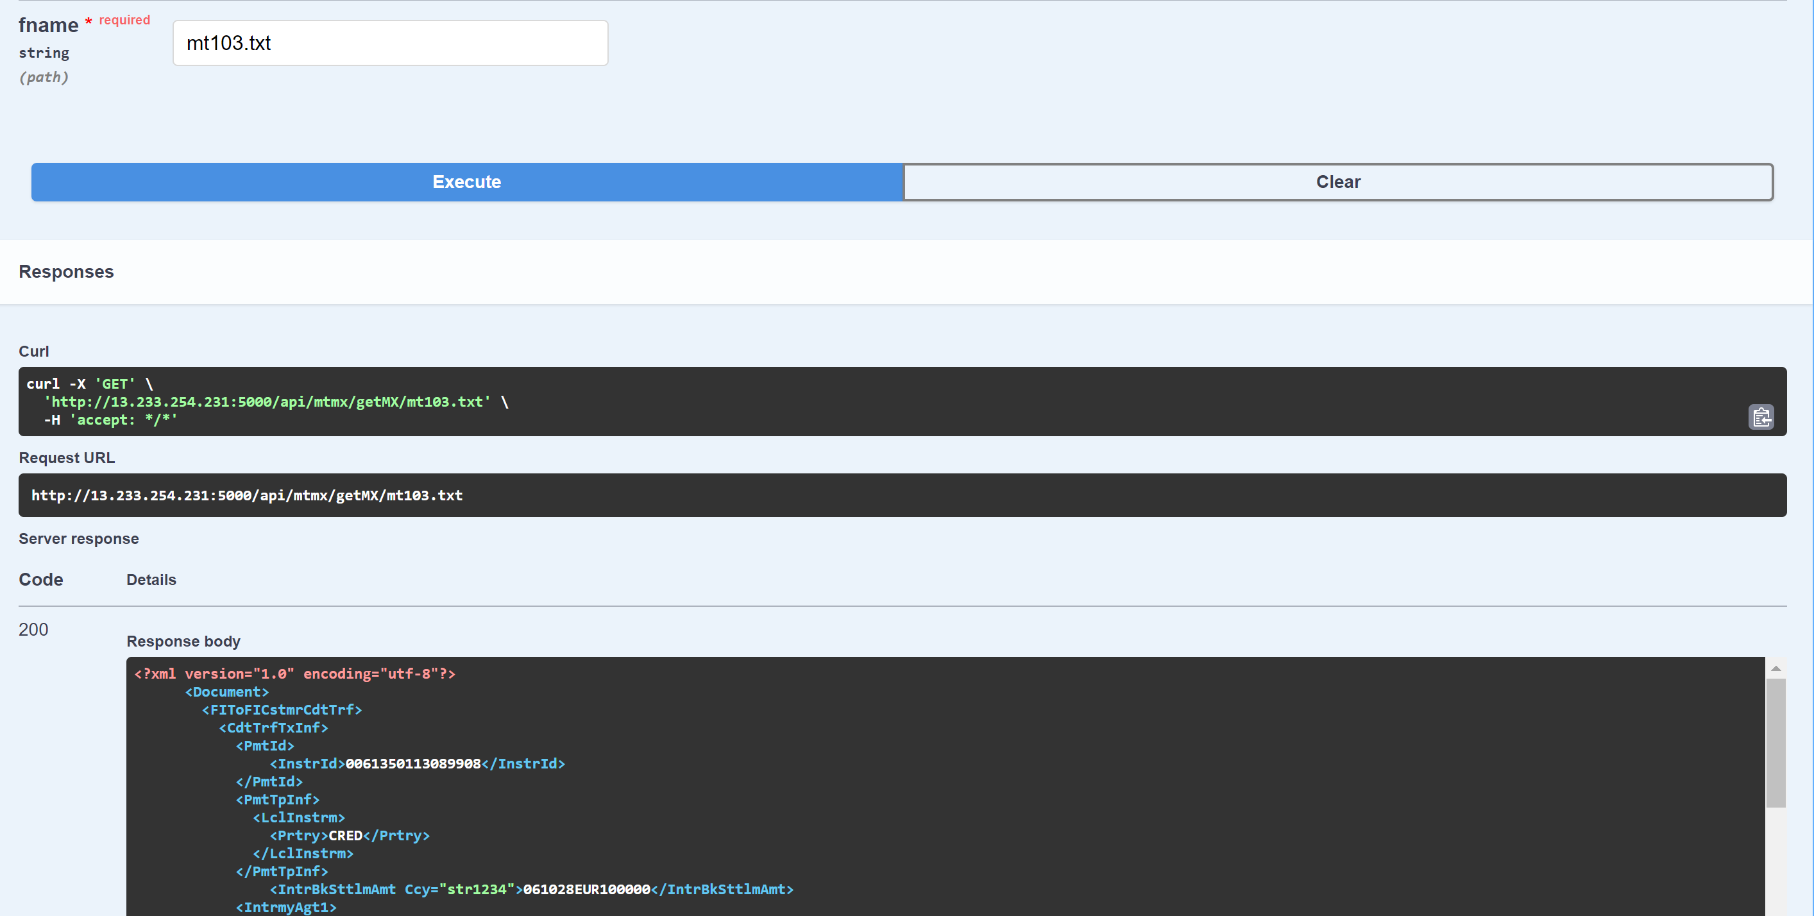
J_Meter Test Results
Unit Testing, Uploads
Unit Testing, getMX

Slide 11
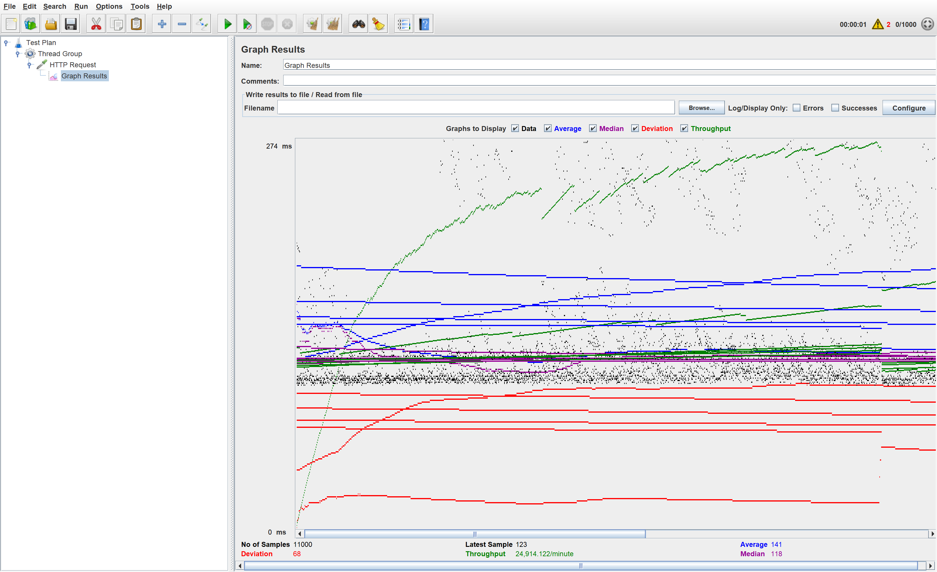
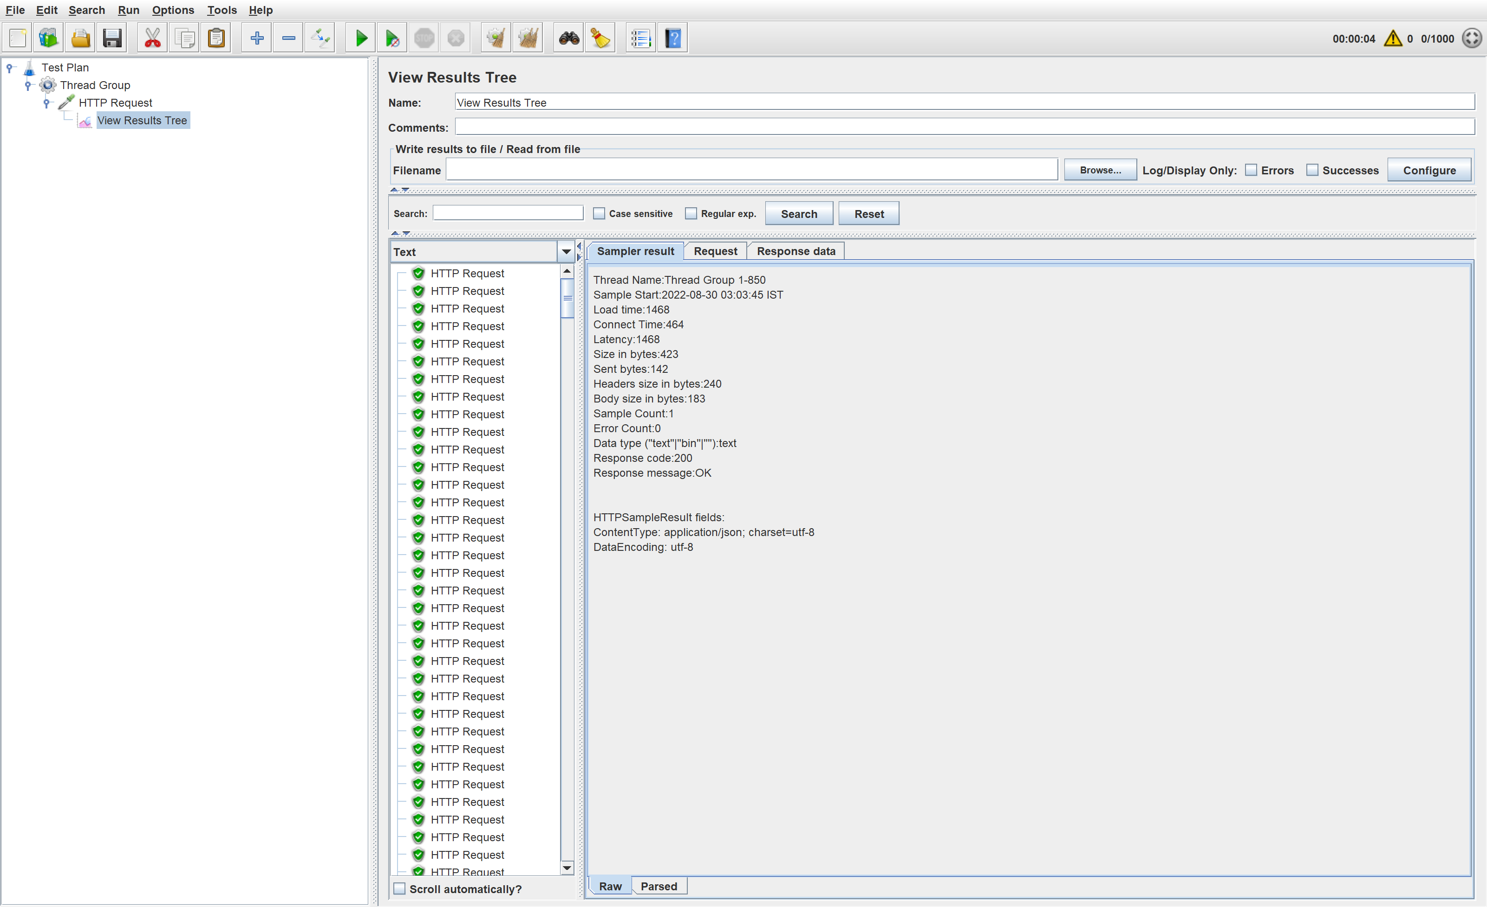
J_Meter Test Results
Graph Results
Result Tree, Verify

Slide 12
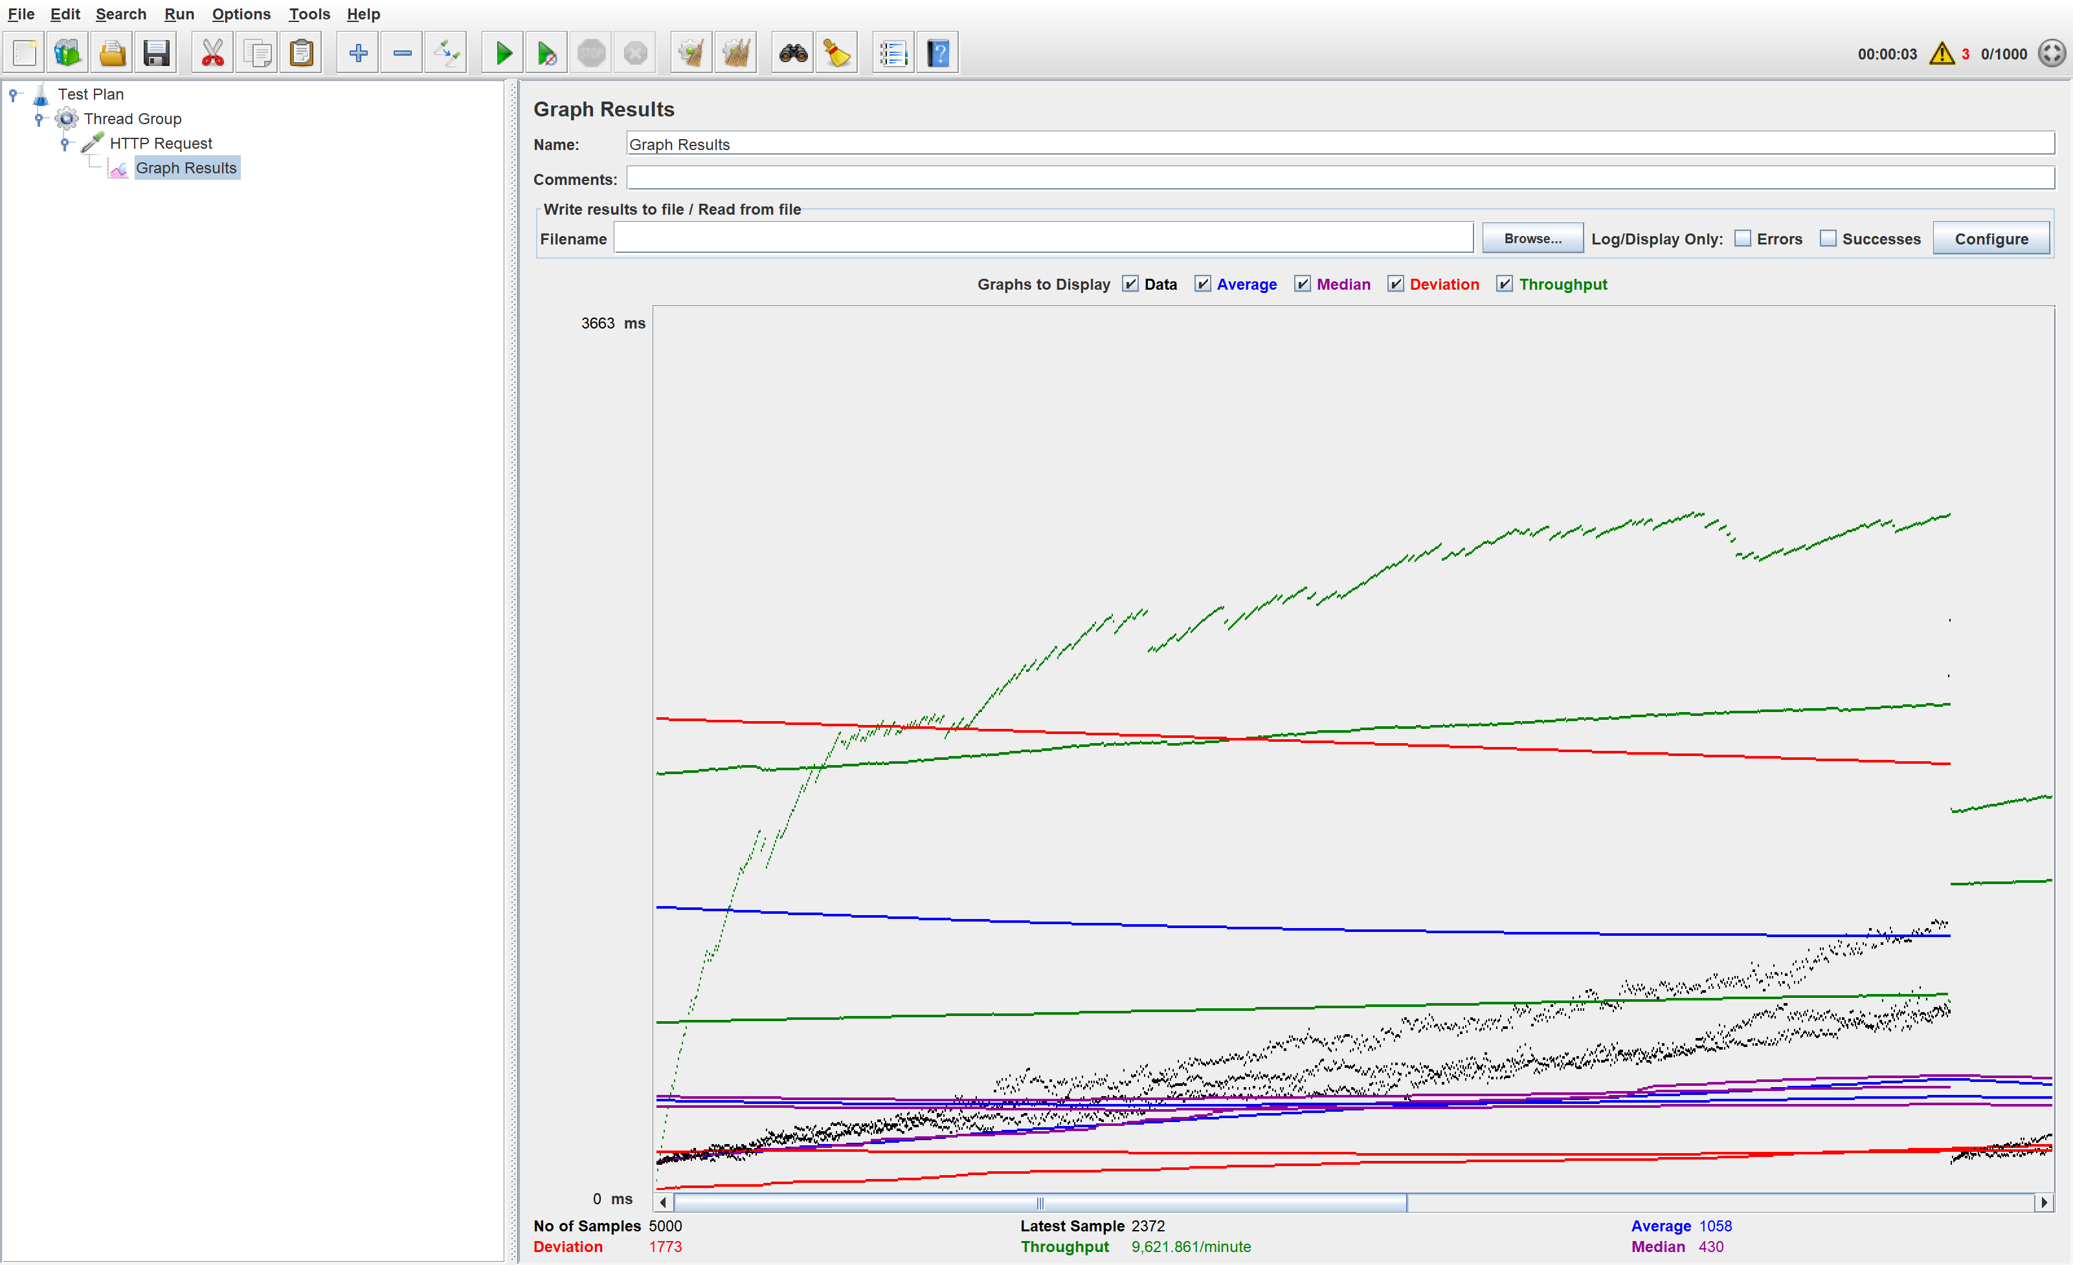
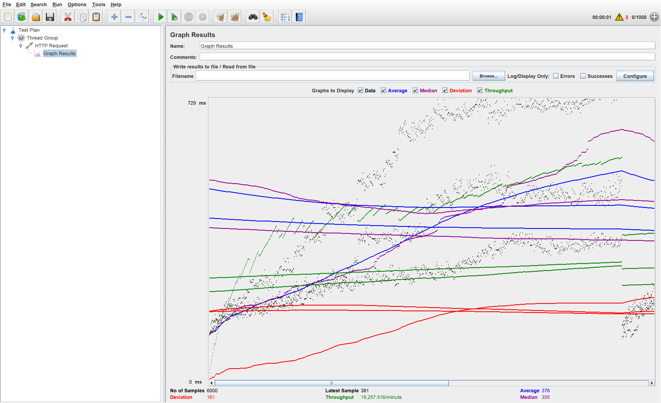
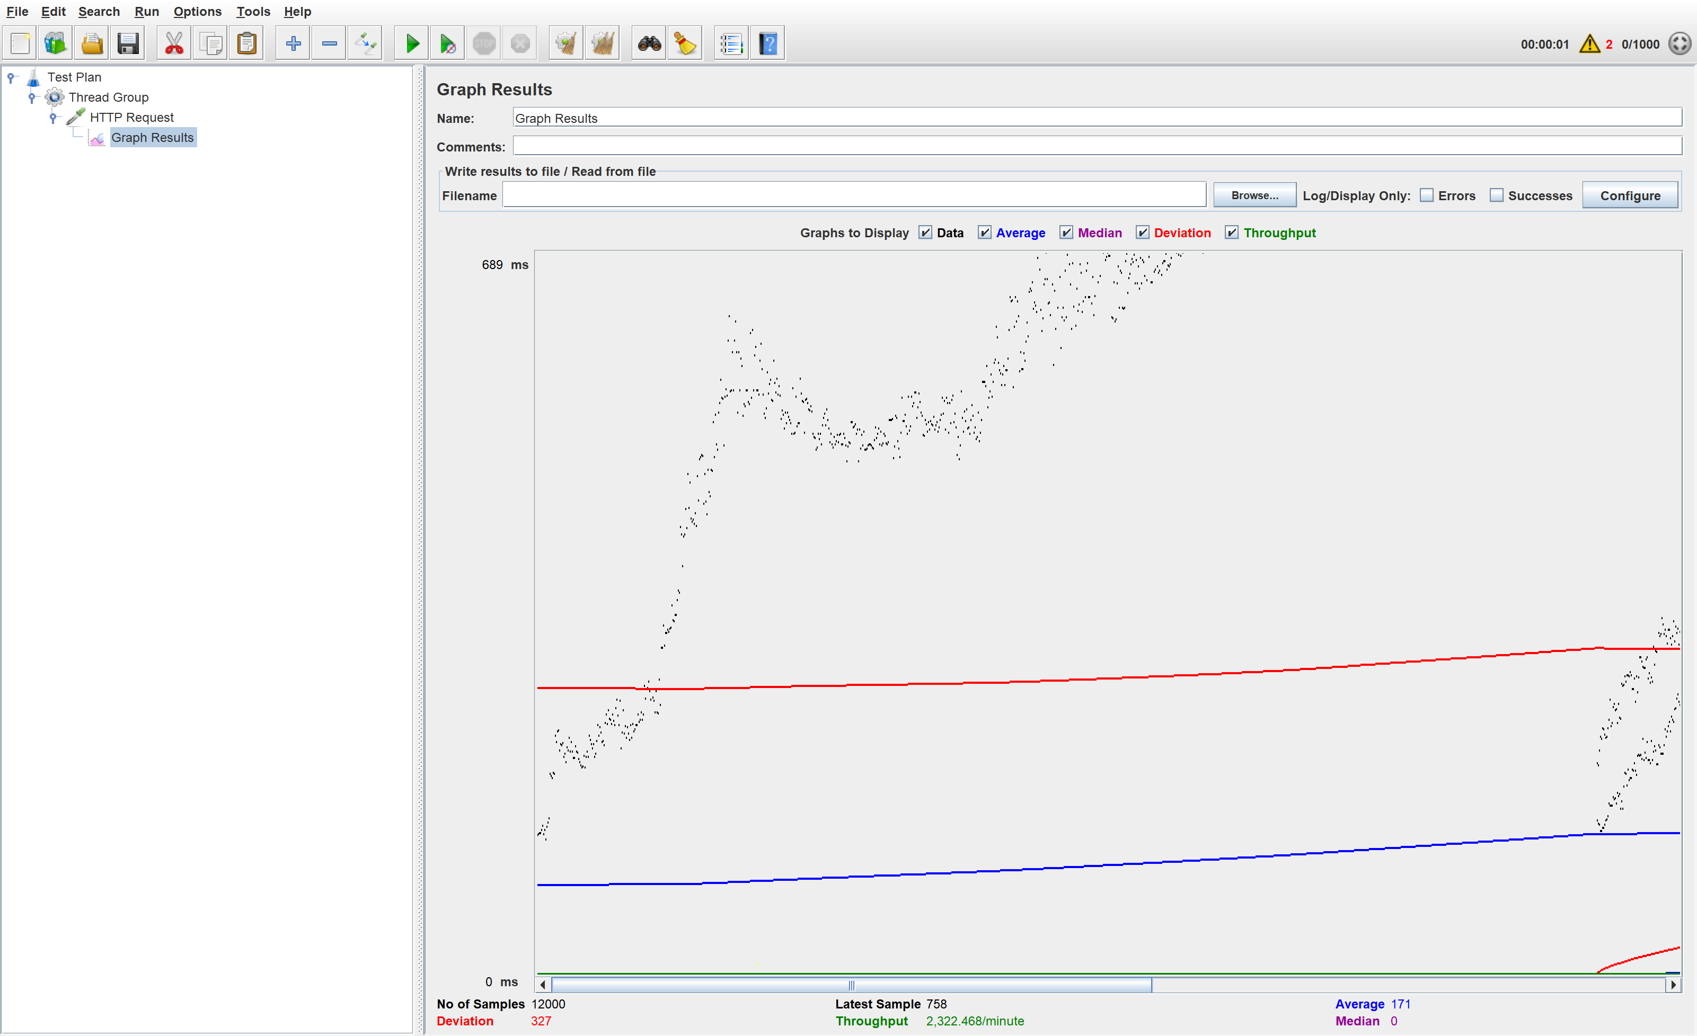
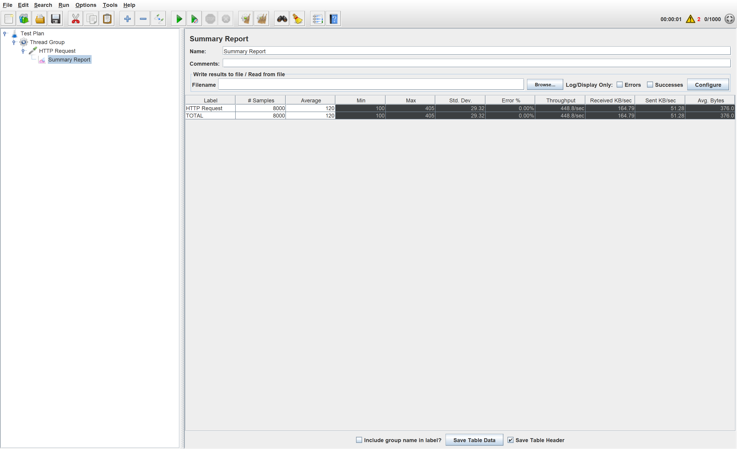

J_Meter Test Results
MX file
Verify file
Upload
Gateway
Gateway
Upload

Slide 13
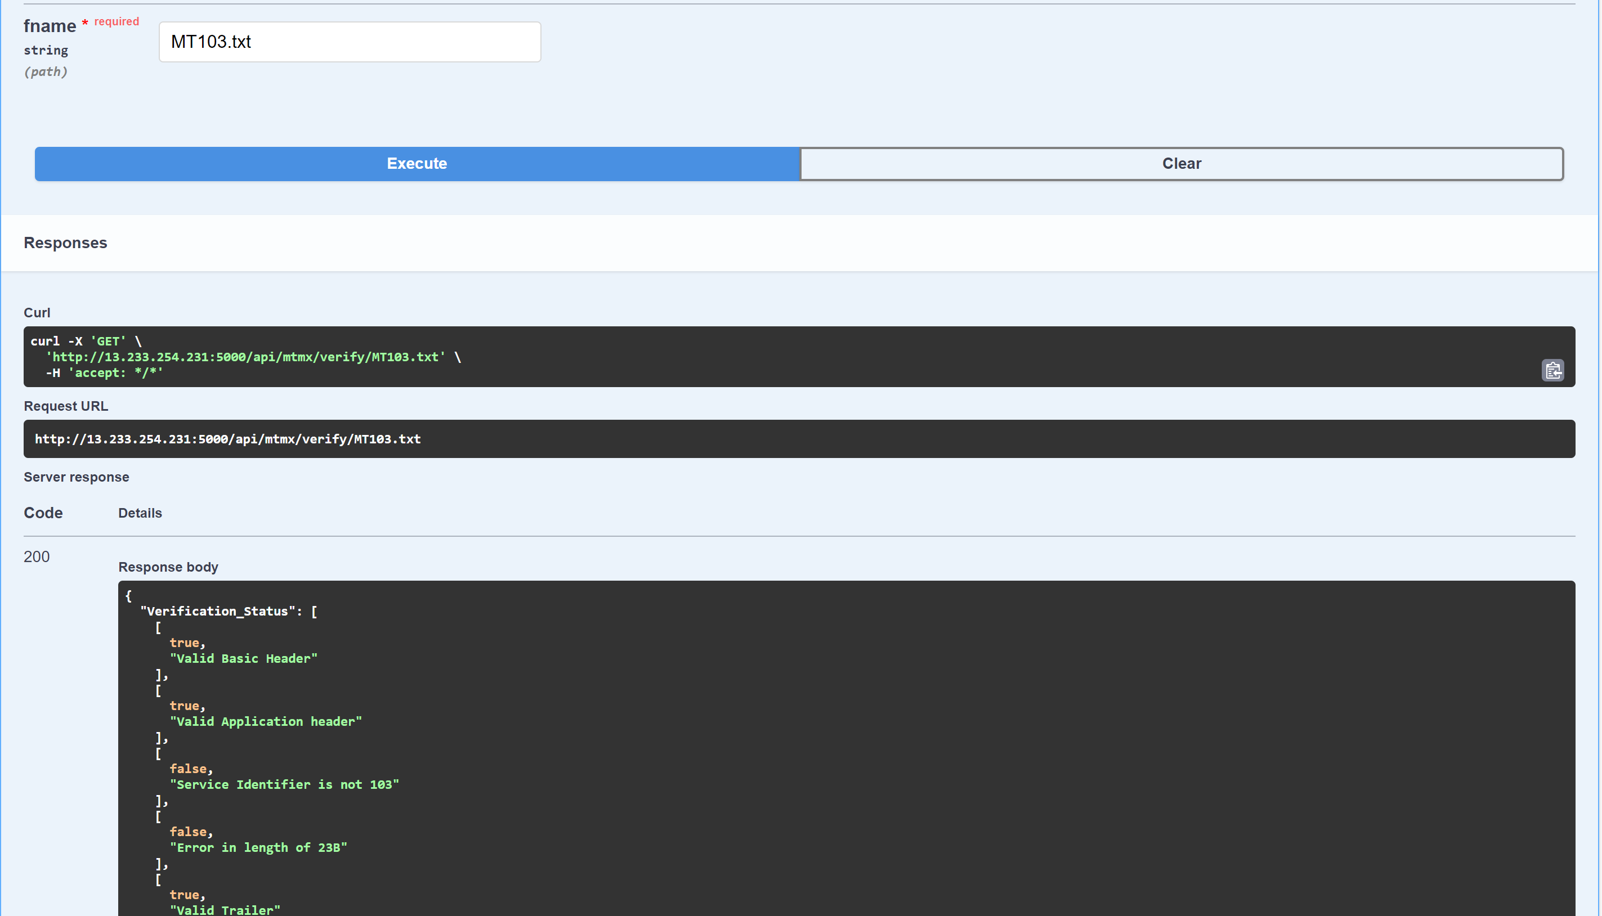
Unit Testing Result
Upload
Verify
Get MX Message

